Slide 1


Slide 2
Module Overview
Course Overview
Accelerated Review of CSS
Summary

Slide 3
Why? Who? What? When? Where? How?
CSS3 Course Overview

Slide 4

Profile of Course Candidate
“I develop/design web sites.”

Slide 5
Scope
“You will have a strong foundation of CSS3 skills and complete this course knowing how (and where)
to ask the right questions to advance to a deeper level.”

Slide 6
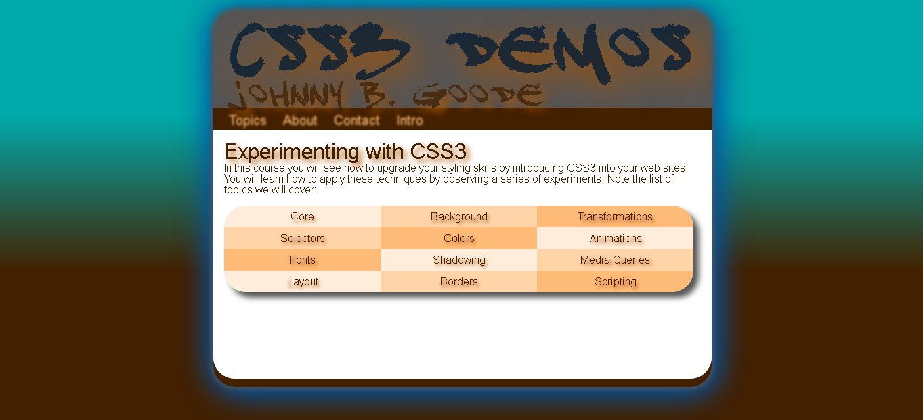
Topics Covered

Slide 7
Cascading Style Sheets
Accelerated Introduction to CSS

Slide 8
CSS Overview
Core Concepts
Implementation Basics
Syntax Examined

Slide 9
Cascading Style Sheets
http://www.w3.org/TR/CSS21/
Abstract
This specification defines Cascading Style Sheets, level 2 revision 1 (CSS 2.1).
CSS 2.1 is a style sheet language that
allows authors and users to attach style (e.g., fonts and spacing) to structured documents (e.g., HTML documents and XML applications). By separating the presentation style of documents from the content of documents, CSS 2.1 simplifies Web authoring and site maintenance.

Slide 10
Cascading Style Sheets
http://www.w3.org/TR/CSS/
CSS Level 3
This section is non-normative.
CSS Level 3 builds on CSS Level 2 module by module, using the CSS2.1 specification as its core. Each module adds functionality and/or replaces part of the CSS2.1 specification. The CSS Working Group intends that the new CSS modules will not contradict the CSS2.1 specification: only that they will add functionality and refine definitions. As each module is completed, it will be plugged in to the existing system of CSS2.1 plus previously- completed modules.

Slide 11
Cascading Style Sheets
http://www.w3.org/Style/CSS/

Slide 12
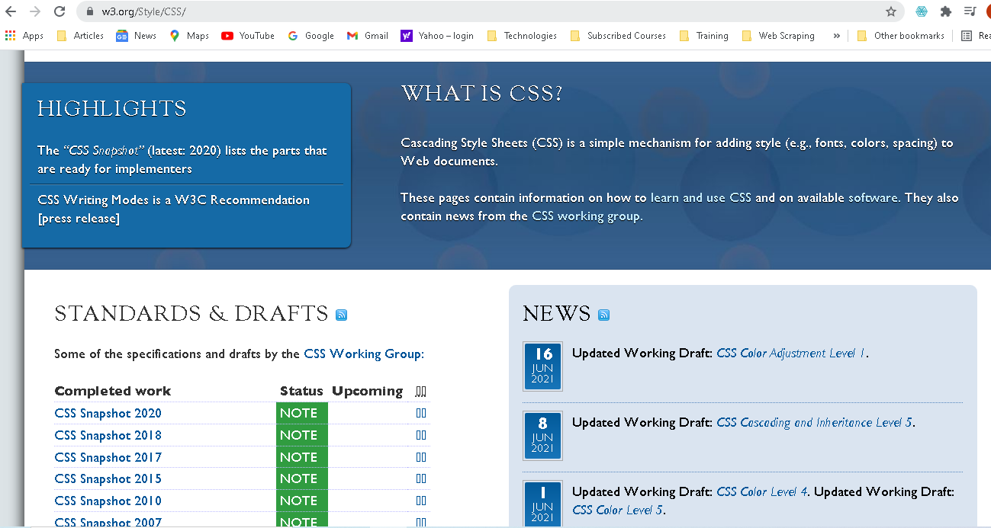

Slide 13
Implementation Basics
/**** INLINE ****/
<div style=“color: #FF0000”></div>

Slide 14
Implementation Basics
/**** DOCUMENT ****/
<head>
<style> div {
color: #FF0000;
}
</style>
</head>

Slide 15
Implementation Basics
/**** EXTERNAL CSS FILE ****/
/* style.css */ div {
color: #FF0000;
}
/* html document */
<head>
<link rel=“stylesheet” href=“style.css” />
</head>

Slide 16
Syntax Examined
/**** FORMATTING ****/
div {color: #FF0000;} div {
color: #FF0000;
}
div
{
color: #FF0000;
}

Slide 17
Syntax Examined
/**** IDs and Classes ****/
#someID {
color: #FF0000;
}
.someClass { color: #FF0000;
}

Slide 18
CSS3 Demos Web Site
DEMO

Slide 19
Summary
Understand the purpose of this course
Feel comfortable with CSS technology concepts

